Slide 1
Evolutionary Computing
Chapter 12
Multiobjective Evolutionary Algorithms

Slide 2
Multiobjective Evolutionary Algorithms
Multiobjective optimisation problems (MOP)
Pareto optimality
EC approaches
Evolutionary spaces
Preserving diversity

Slide 3
Multi-Objective Problems (MOPs)
Wide range of problems can be categorised by the presence of n possibly conflicting objectives:
buying a car: speed vs. price vs. reliability
engineering design: lightness vs. strength
Two problems:
finding a set of good solutions
choosing the best solution for a particular application

Slide 4


An example: Buying a car
speed
cost

Slide 5
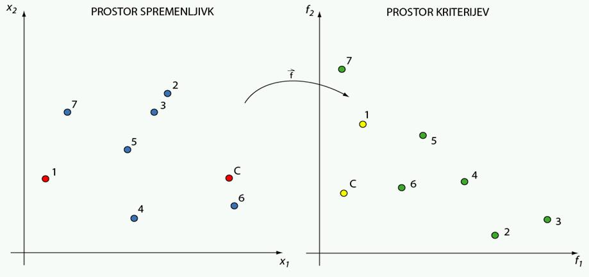
Two spaces
Decision space (variable space solution space)
Objective space
E.g., HorsePower and materials
E.g., speed and cost
Details we can control
Criteria by which we choose

Slide 6
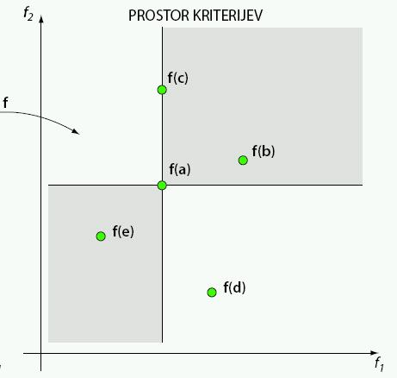
Comparing solutions
Objective space
Optimisation task: Minimize both f₁ and f₂
Then:
a is better than b
a is worse than e
a is better than c
they are equal on f₁
a wins on f₂
a and d are incomparable:
a wins on f₁
d wins on f₂

Slide 7
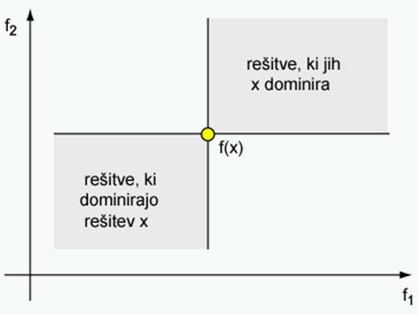
Dominance relation
Solution x dominates solution y, (x y), if:
x is better than y in at least one objective,
x is not worse than y in all other objectives
solutions dominated by x
Number of “slaves”
solutions dominating x
Number of “masters”
Rememeber: mimization problem

Slide 8
Pareto optimality
Solution x is non-dominated in a set of solutions Q if no solution from Q dominates x (has no “master” in Q)
Pareto-optimal set: a set of non-dominated solutions in the solution space. (Q = set of all feasible solutions) Its members are the Pareto-optimal solutions
Pareto-optimal front: an image of the Pareto-optimal set in the objective space

Slide 9
Illustration of the concepts
f₂(x)
min
f₁(x)
min

Slide 10
Illustration of the concepts
f₂(x)
min
f₁(x)
min

Slide 11
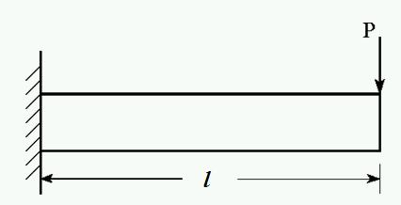
Example: beam design problem
Minimize weight and deflection of a beam (Deb, 2001):
d
Decision (variable) space: length l and diameter d
Objective space: weight and deflection

Slide 12
Formal definition
Minimize
minimize
subject to
where
(beam weight)
(beam deflection)
(maximum stress)

Slide 13
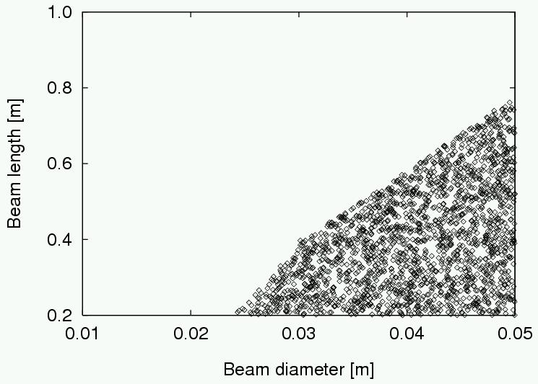
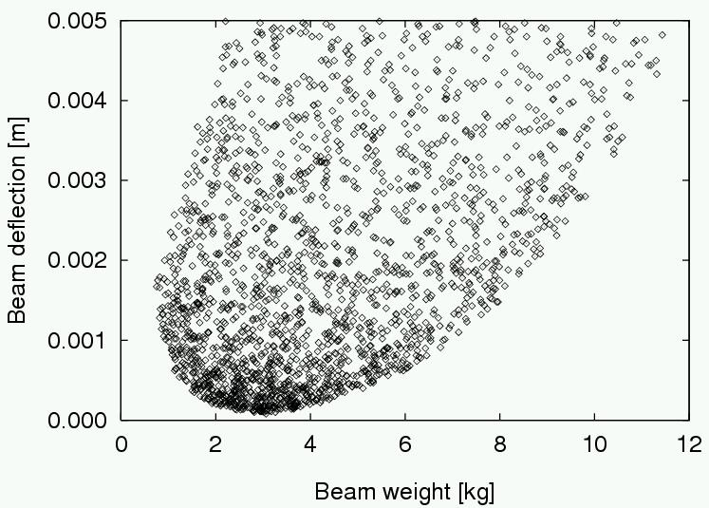
Feasible solutions
Decision (variable) space
Objective space

Slide 14
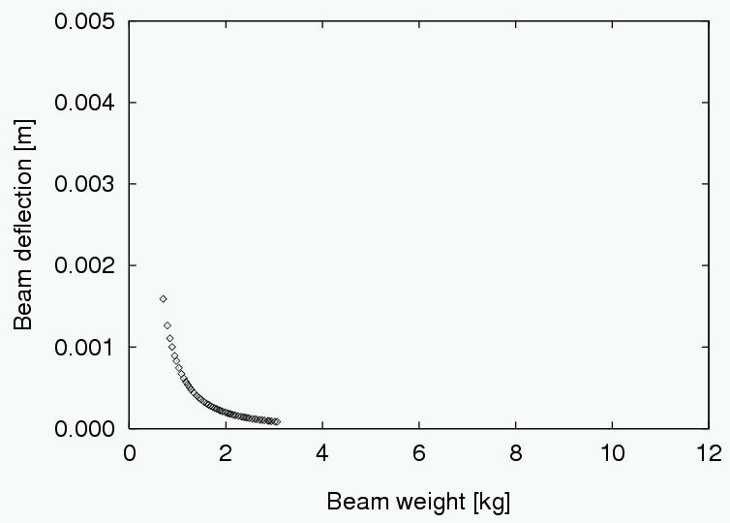
Goal: find non-dominated solutions

Slide 15
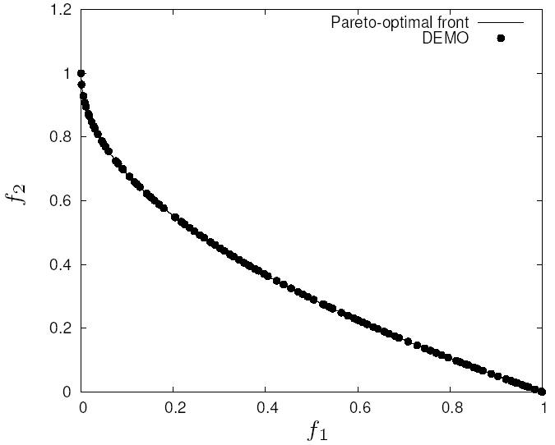
Goal of multiobjective optimisers
Find a set of non-dominated solutions (approximation set) following the criteria of:
convergence (get as close as possible to the Pareto-optimal front),
diversity (spread, distribution)

Slide 16
Single vs. multiobjective optimisation
Characteristic | Single objective optimisation | Multiobjective optimisation
Number of objectives | one | more than one
Spaces | two: decision (variable) space, objective space | two: decision (variable) space, objective space
Comparison of candidate solutions | x is better than y | x dominates y
Result | one (or several equally good) solution(s) | Pareto-optimal set
Algorithm goals | convergence | convergence, diversity

Slide 17
Two approaches to multiobjective opt.
Preference-based, a.k.a. aggregation-based approach: traditional, using single objective optimisation methods
Real multiobjective approach: possible with novel multiobjective optimisation techniques, enabling better insight into the problem

Slide 18
Preference- or aggregation-based approach
Transform the problem into a single objective one, and
Solve it with a single objective optimisation method
For the transformation use higher level information that imply preferences on the importance of objectives
Example: set weights for objectives & make a weighted sum to be the single objective
The weights represent the relative importance of the objectives
This results in a particular trade-off solution

Slide 19
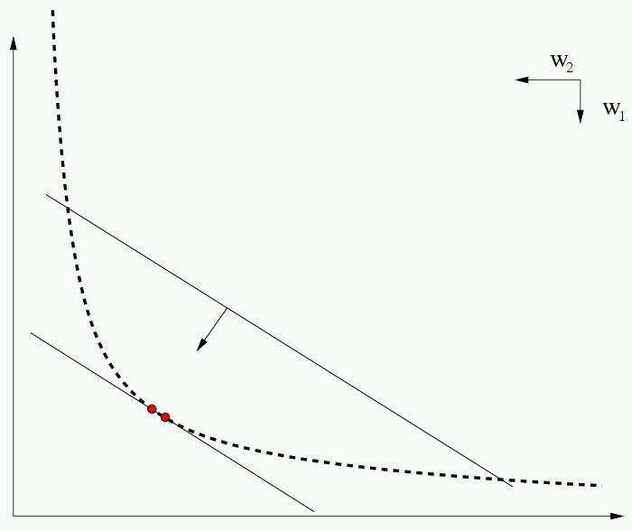
An example approach: Weighted-sum
Modified problem:
Weights define an angle, hence hyperplanes in the objective space, these define the Pareto front

Slide 20
Real multi-objective approach
Use a multiobjective optimisation method
This results in multiple trade-off solutions
To choose a particular trade-off solution use higher-level information / preferences on importance of objectives
These preferences may not be quantified in advance, and may not be quantifiable at all

Slide 21
EC approach for multiobjective optimisation
Main rationale:
EAs are population-based methods, hence inherently
Well suited to return a set of trade-off solutions (approximation set) in a single run
This allows for both
the aggregation-based approach and
the real multiobjective approach

Slide 22
EC approach: Advantages
Population-based nature means EA can simultaneously search for a set of points approximating Pareto front
No need to make guesses before or during the search about which trade-offs (weights) might be useful
No assumptions needed about the shape of the Pareto front - can be convex / discontinuous, etc.

Slide 23
EC approach: Requirements
We need:
Appropriate method to define fitness,
usually based on dominance (e.g., number of slaves or masters)
Method to maintain diversity in the set of points
this challenge and the useful “tricks” are similar to multi-modal problems
Method to remember all good points seen during the search
usually using elitism or an archive

Slide 24
EC approach: Fitness Assignment
Could use aggregation-based approach and change weights during evolution
no guarantees
Different parts of population can use different criteria
e.g. VEGA, but no guarantee of diversity
Dominance
ranking
fitness related to whole population

Slide 25
EC approach: Diversity maintenance
Usually done by niching techniques such as:
fitness sharing
adding a number to fitness based on inverse distance to nearest neighbour (when fitness is to be minimised)
(adaptively) dividing search space into boxes and counting occupancy
All rely on some distance metric in the genotype / phenotype space

Slide 26
EC approach: Remembering Good Points
Could just use elitist algorithm
e.g. ( μ + λ ) replacement
Common to maintain an archive of non-dominated points
some algorithms use this as a second population that can be used in recombination (Hall of Fame)
others divide archive into regions too

Slide 27
Important points
Multi-objective problems occur very frequently
EAs are very good in solving multi-objective problems
MOEAs are one of the most successful EC subareas
Number of objectives is typically low in practice and research, current State of the Art is about 2 or 3, more than 3 are seen as “many-objective” problems

